Slide 1
Evaluating Election Schemes Under Strategic Voting
William Hawkins | CSCI 6967 | 20 MAR 2023

Slide 2

What is the best voting scheme?
There are a plethora of proposed voting schemes in the discourse.

Slide 3
Importance of establishing a best voting scheme
Push for ranked voting in USA still has significant resistance.
Major argument of opposition is the ranked voting proponents can’t even agree on a method of ranked voting.
High consequences to choosing a ‘bad’ voting scheme.
Plurality voting is bad!

Slide 4
Previous Work
“A Precise Method for Evaluating Election Schemes” (Bordley)
Comparing strategic voting incentives in plurality and instant-runoff elections” (Eggers, Nowacki)

Slide 5
The Proposal
Evaluate the strength of various voting schemes according to some social welfare function.
Geometric Median
Geometric Mean
Evaluate the following schemes:
Plurality
Borda Count
Instant Runoff Voting
Copeland
Simpson’s Rule (maximin)
Condorcet
Single Random Ballot

Slide 6
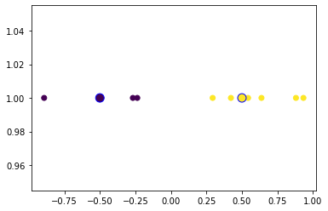
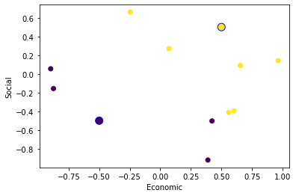
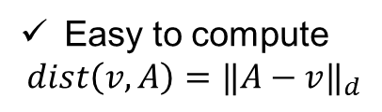
The Proposal: Voters in Euclidian Space
Easy to compute
$$dist\left(v,A\right)={‖A−v‖}_{d}$$

Slide 7
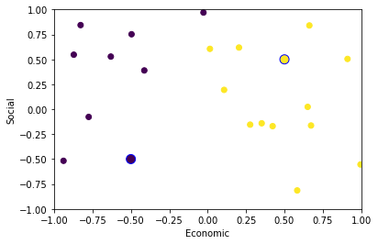
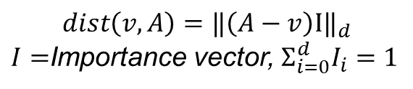
The Proposal: Voters in Euclidian Space with Weighted Dimensions
$$dist\left(v,A\right)={‖\left(A−v\right)I‖}_{d}$$
$I=$Importance vector, $Σ_{i=0}^{d}I_{i}=1$

Slide 8
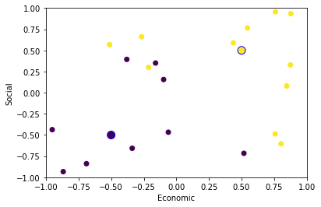
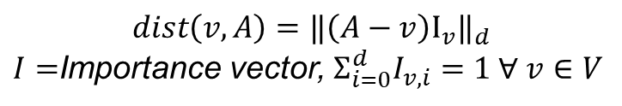
The Proposal: Voters in Euclidian Space with Weighted Dimensions
Importance vector may be
different for each voter.
$$dist\left(v,A\right)={‖\left(A−v\right)I_{v}‖}_{d}$$
$I=$Importance vector, $Σ_{i=0}^{d}I_{v,i}=1 ∀ v∈V$

Slide 9
Timeline
This week
Remake Election, and Voting scheme classes.
Next week
Strategic Voting
Further on
Possible parallelization
Decentralized Tabulation

Slide 10
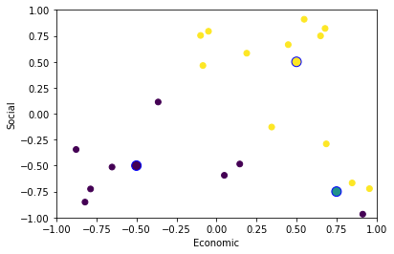
Strategic Voting
Pre-election poll
Yellow | Purple | Blue
45% | 45% | 10%

